Slide 1
Predicting Employee Attrition

Slide 2
What is attrition?
Attrition is a terminology in human resources which refers to the employees leaving the company.

Slide 3
Why do we predict employee attrition?
High attrition is problematic for companies that causes the huge loss. The loss is not only in terms of the money but also the company sometimes loses the skilled employees who are the most valuable assets to the company (Morrison, 2014).

Slide 4
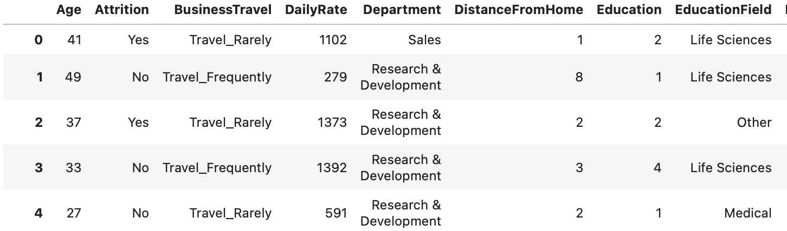
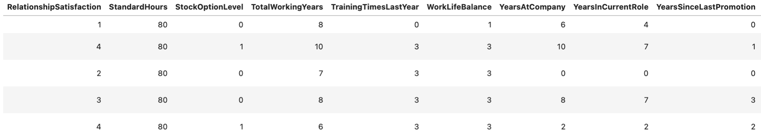
IBM HR Analytics Employee Attrition Dataset

Slide 5
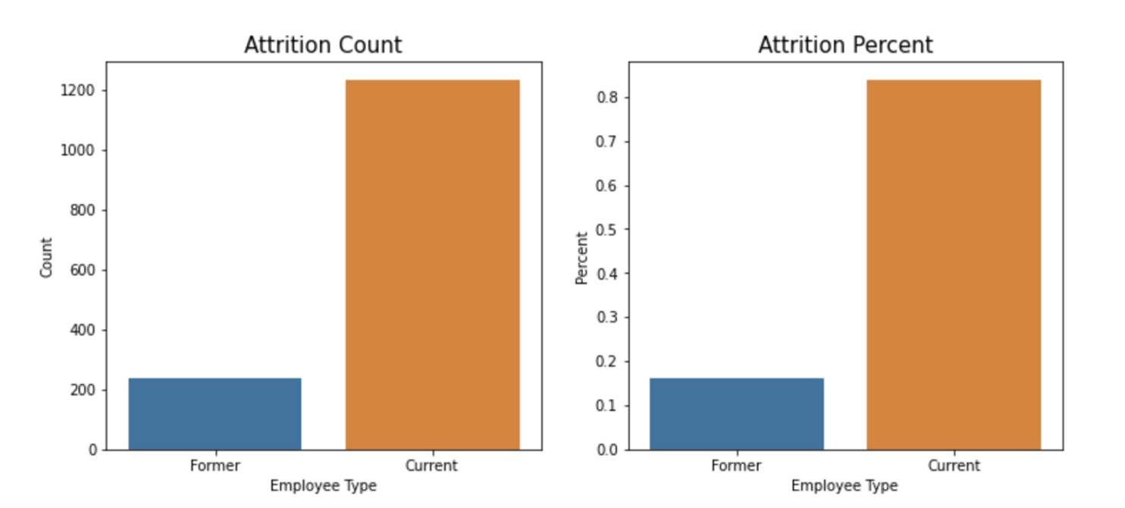
We have imbalance data.
1233 employees stayed, 237 employees left.

Slide 6
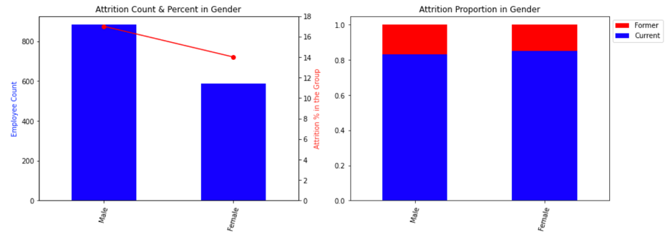
17% of Male and 14% of Female Leave the Company.

Slide 7
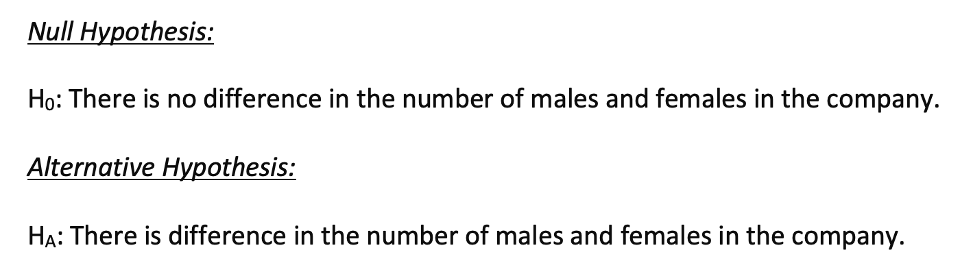
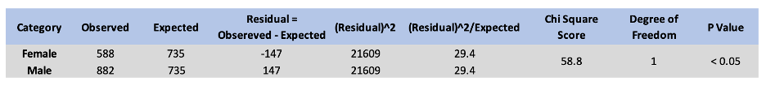
Gender Equal Opportunity

Slide 8
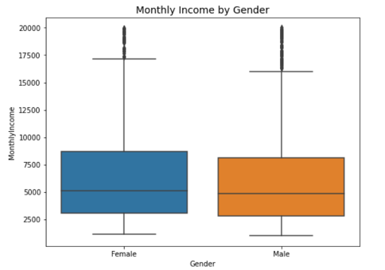
There is no gender disparity in income.

Slide 9
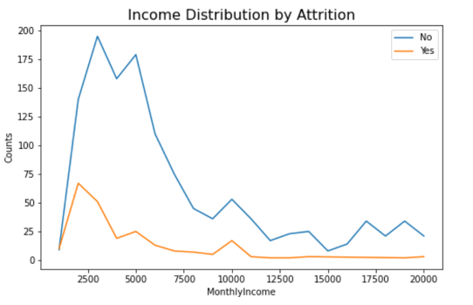
Attrition rate is high at low income level.

Slide 10
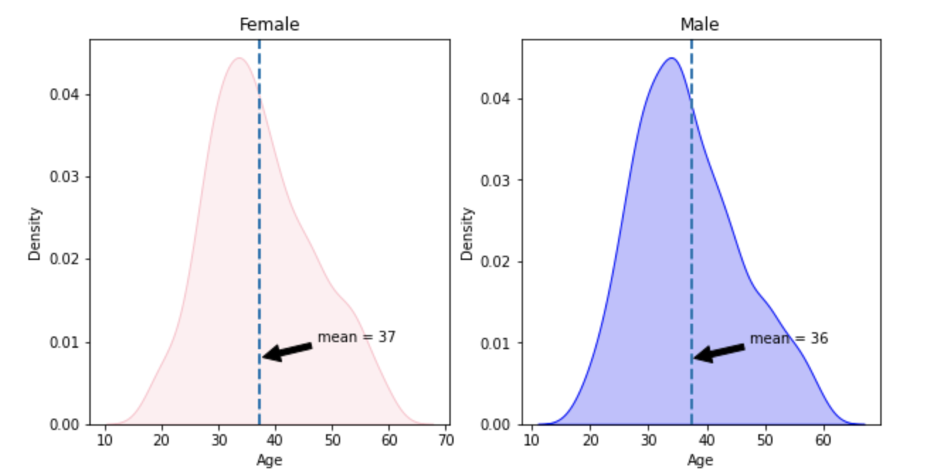
Average age between genders

Slide 11
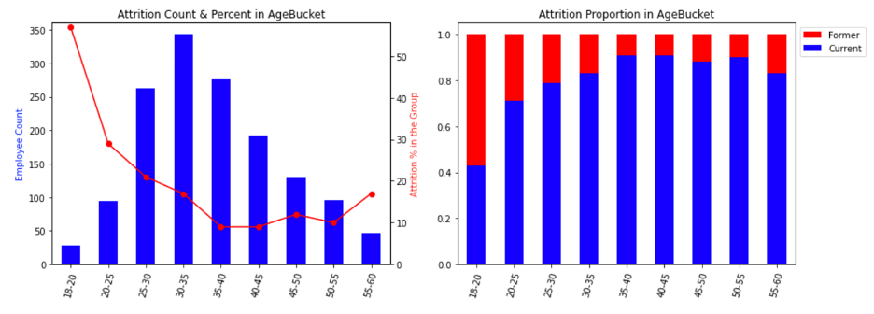
Age

Slide 12
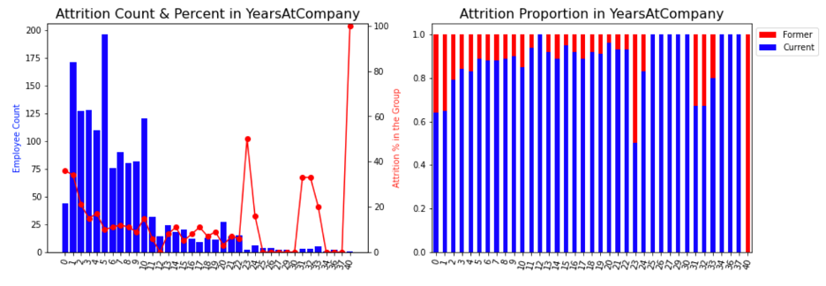
Years at company.

Slide 13
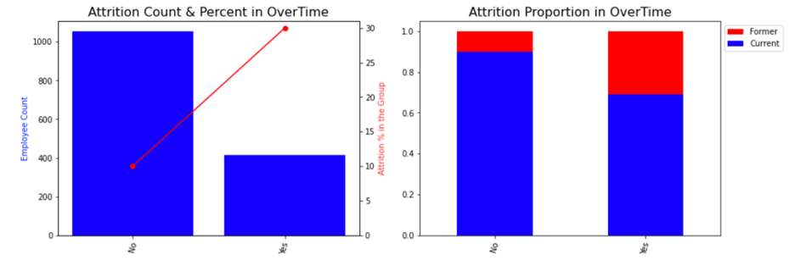
Over Time

Slide 14
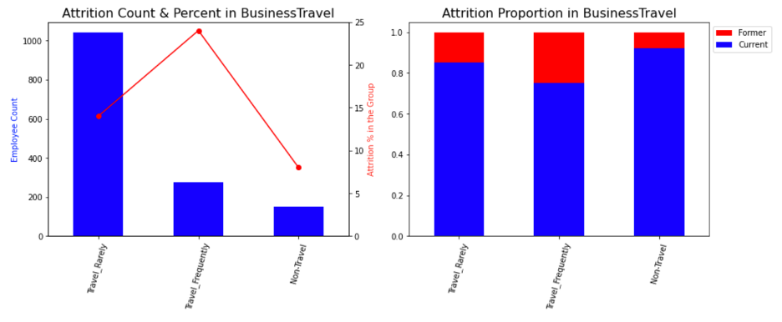
Business Travel

Slide 15
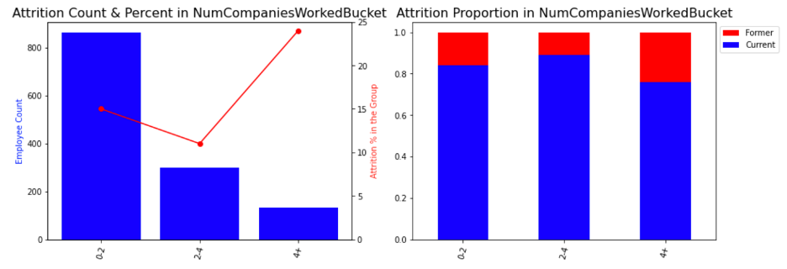
Number of companies worked before.

Slide 16
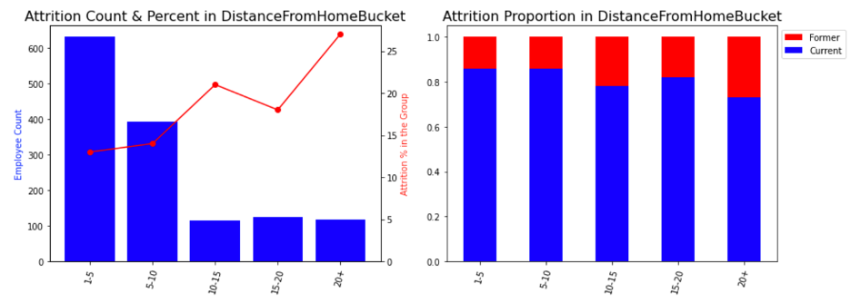
Distance from home

Slide 17
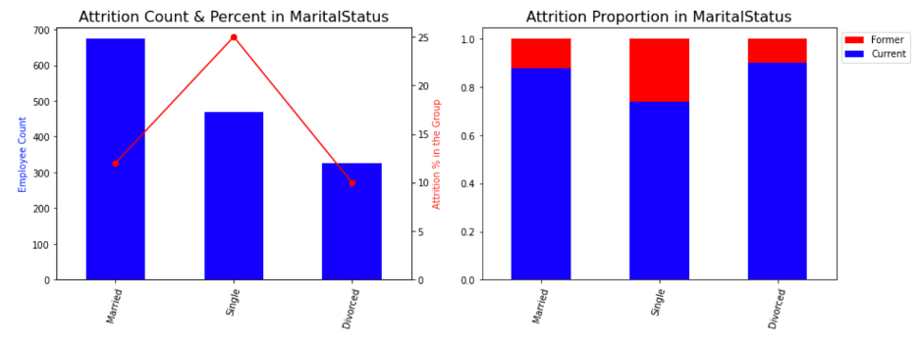
Single people tend to leave.

Slide 18
Applies Machine Learning ALgorithms
Logistic Regression
Random Forest Classifier
Kth Nearest Neighbor (KNN)
Support Vector Machine
Gradient Boosting
ADA Boosting

Slide 19
Right evaluation metric is f1-score for this business problem.

Slide 20
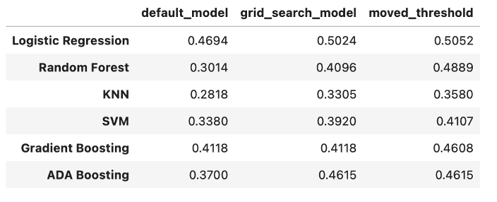
Logistic regression gives higher F1 score

Slide 21
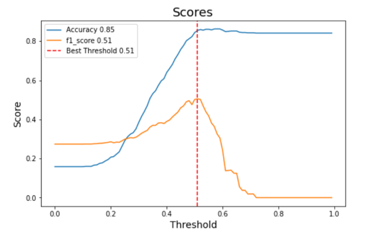
F1 score is high when threshold is 0.51.

Slide 22
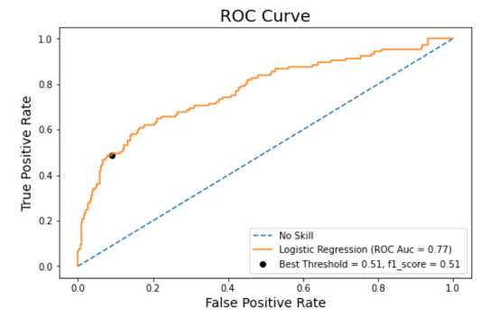
Area under curve is 0.77.
The Machine Learning Predictive Model has been successful in effectively classifying 77% unknown (Validation Set) examples correctly.

Slide 23
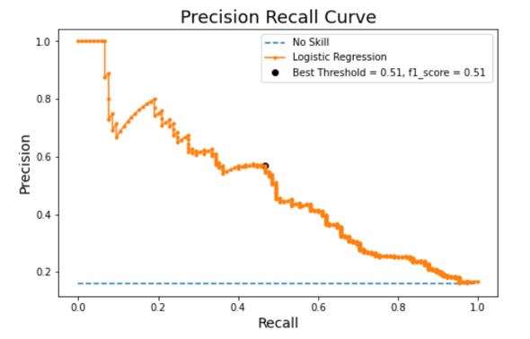
Precision Recall curve is pretty different than no skill line.

Slide 24
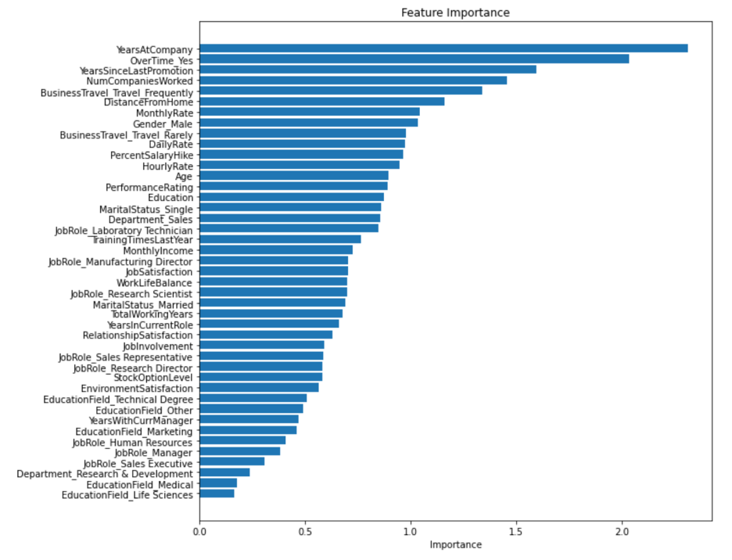
Feature Importance

Slide 25
Top 6 Important Features
Years at Company
Overtime
Years Since Last Promotion
Number of Companies Worked
Business Travel
Distance from Home

Slide 26
Recommendations

Slide 27
Years at Company
23% of employees have two years or less working experience in the company and 30% of those employees leave the company. The model shows that number of years at company is the strongest factor in attrition. Employees who are in their first years are more likely to leave the company. Employees who have gained working experience prefer to stay in the company. Therefore, the company should understand why their new employees leave the company.

Slide 28
Overtime
28% of employees works overtime in the company and 30% of those employees leave the company. The model also shows that overtime work is the second strongest factor in attrition. Therefore, the company should understand the reason why they are working overtime. Is it for too high workload or are employees' qualifications not enough to complete the scheduled tasks on time? There might be some other reasons behind that. Our recommendation will be to understand the reason(s) for overtime with detail research and take appropriate measures to reduce the factors behind this attrition factor.

Slide 29
Years since last promotion
There are 1097 employees who have less than 2 years since last promotion and 16% of those employees leave the company. Attrition rate increases if the number of years increases since the last promotion. Because of this reason, the company should review the promotion policy. They can make promotion requirements clear to all employees how and when they can be promoted.

Slide 30
Number of companies worked before
9% of employees worked in 4 or more companies before this company and 24% of those employees leave the company. The company should understand why those employees are leaving the company. The company can question the applicants why they want to quit the previous job during interview process. The company can even get in touch with previous company.

Slide 31
Business travel
19% of the employees travels frequently and 70% of those employees leave the company. This is one of the strongest factors in employee attrition. The company should understand if a high number of business travels are really necessary. They can adjust the frequency. If they can’t, they can give some extra incentives to motivate those employees.

Slide 32
Distance from home
24% of the employees live more than 10 miles away from the company and 22% of those employees leave the company. The company should understand how distance is affecting their work. They can support their employees to move closer areas to the company by providing moving expenses. If they can’t move closer due to their mandatory things, the company can adjust their work shift to prevent employees wasting their time from rush hours. The company can enable some days to working from home if they can.

Slide 33
Thank you!

